Slide 1
Chapter 1
Fundamentals of
Algorithm Efficiency Analysis

Slide 2
Mathematical Analysis of Non-recursive Algorithms

Slide 3

Guideline for Analyzing Time Efficiency of Non-recursive Algorithms:
Decide on a parameter (or parameters) as an input’s size.
2. Identify the algorithm’s basic operation. (As a rule, it is located in its innermost loop.)
3. Check whether the number of times the basic operation is executed depends only on the size of an input.
If it also depends on other additional properties, then investigate the worst-case (O), best-case ( Ω), and, if necessary, average-case (Θ ) efficiencies.
4. Set up a sum expressing the number of times the algorithm’s basic operation is executed.
Using standard formulas and rules of sum manipulation (summations),
either find a closed-form formula for the count, such as an² + bn + c;
or, at the very least, establish its order of growth, such as Θ(n²).

Slide 4

Mathematical Analysis of Nonrecursive Algorithms
Example 1.22: MaxElement(A[0..n-1])
Assume that a given list of n numbers is implemented as a array A[0..n-1].
Find the value of the largest elements in a list of n numbers.
Algorithm MaxElement( A[0 .. n-1] )
//Determines the value of the largest element in a given array.
Input: An array A[0 .. n-1] of real numbers
Output: The value of the largest element in A
maxVal ← A[0];
for (i ← 1 to n – 1) do {
{ if (A[i] > maxVal)
maxVal ← A[i];}
return maxVal; }

Slide 5
Analysis Framework (in analyzing non-recursive algorithm):
Measuring an input’s size: (decide on a parameter(s) as an input size)
The number of n elements in the array.
Units for measuring running time (identify the algorithm’s basic operation.
As a rule, it is located in its inner-most loop):
In the for-loop body, we have two operations
a. the comparison operation A[i] > maxVal and
b. the assignment operation maxVal ← A[i]
The basic operation for this algorithm is
the comparison operation > of the boolean expression A[i] > maxVal ,
the comparison operation > is executed for each repetition of the loop
but not the assignment operation ←.

Slide 6
Analysis Framework (in analyzing non-recursive algorithm):
Check whether the number of times the basic operation is executed depends only on the size of an input.
If it also depends on some additional properties, then investigate separately
the worst-case (O),
average-case (Θ ), and if necessary,
best-case ( Ω)
efficiencies.
4. Set up a sum expression for the number of times the algorithm’s basic operation is executed.
5. Using standard formulas and rules of sum manipulation, either find a closed form formula for the count or, at the very least, establish its order of growth.

Slide 7
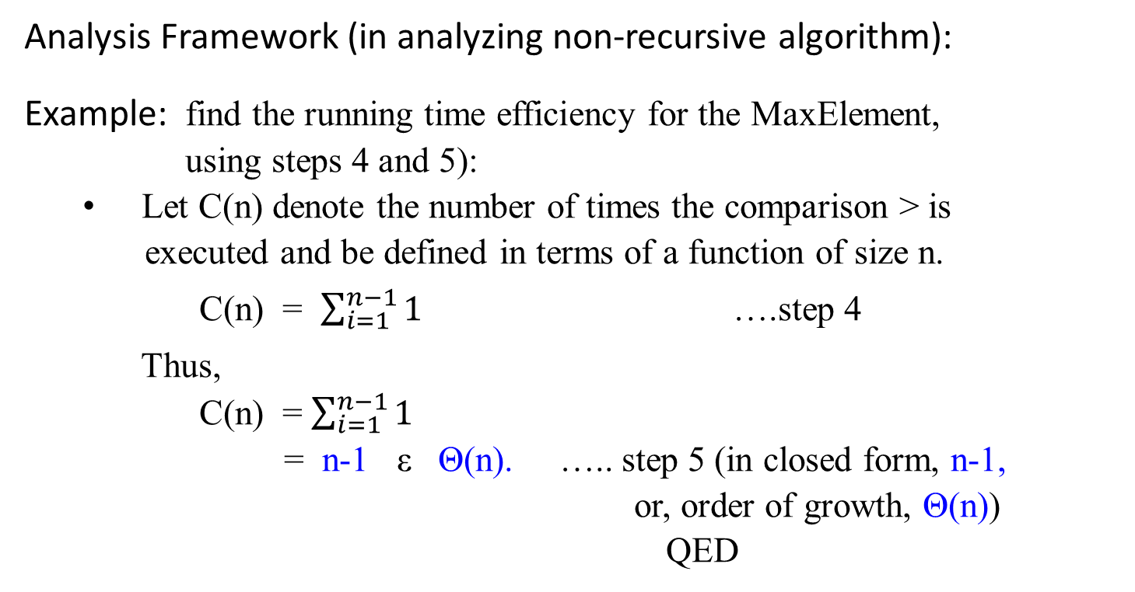
Algorithm MaxElement( A[0 .. n-1] )
Input: An array A[0 .. n-1] of real numbers
Output: The value of the largest element in A
maxVal ← A[0];
for (i ← 1 to n – 1) do {
{ if (A[i] > maxVal)
maxVal ← A[i];}
return maxVal; }
Analysis Framework (in analyzing non-recursive algorithm):
Example: find the running time efficiency for the MaxElement, using steps 4 and 5):
Let C(n) denote the number of times the comparison > is
executed and be defined in terms of a function of size n.
C(n) = $\sum_{i=1}^{n−1}{1}$ ….step 4
Thus,
C(n) = $\sum_{i=1}^{n−1}{1}$
= n-1 ε Θ(n). ….. step 5 (in closed form, n-1,
or, order of growth, Θ(n))
QED

Slide 8
Mathematical Analysis of Recursive Algorithms
Methods for Solving Recurrence Relations of Given Recursive Algorithms

Slide 9

Example Problems – Towers of Hanoi
States: combinations of poles and disks
Operators: move disk x from pole y to pole z subject to constraints
cannot move a disk on top of a smaller disk
cannot move a disk if other disks on top of the disk
Goal test: disks from largest (at the bottom) to smallest on the goal pole
Path cost: 1 per move
Towers of Hanoi applet
1 2 3

Slide 10
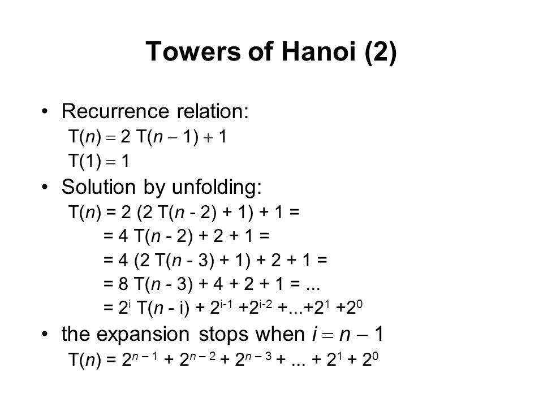
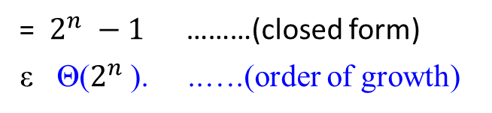
Example Problems – Towers of Hanoi
= $2^{n} −1$………(closed form)
ε Θ($2^{n}$). ..….(order of growth)

Slide 11
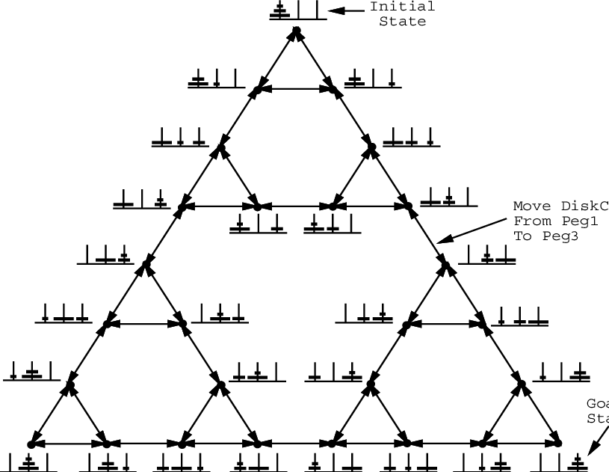
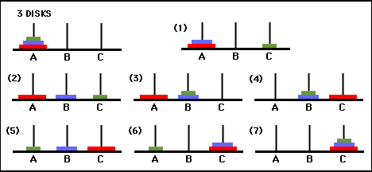

Slide 12
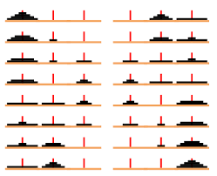
Disks | Move
1 | 1
2 | 3
3 | 7
4 | 15
5 | 31
6 | 63
7 | 127
8 | 255
9 | 5111023
10

Slide 13
n | Number of moves using the 3-peg algorithm | Number of moves using the 4-peg algorithm
1 | 1 | 1
2 | 3 | 3
3 | 7 | 5
4 | 15 | 9
5 | 31 | 13
6 | 63 | 17
7 | 127 | 25
8 | 255 | 33
9 | 511 | 41
10 | 1023 | 49
16 | 65535 | 161
32 | 4294967295 | 1281
64 | 18446744073709551615 | 18433
 | T(n) = 2 T(n-1) + 1 T(n) = n² – 1 T(1) = 1

Slide 14

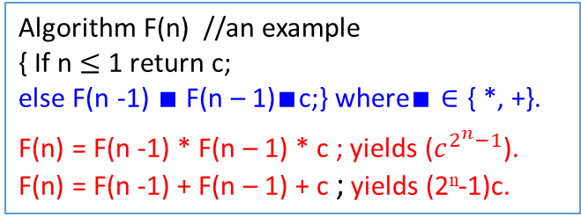
Algorithm F(n) //an example
{ If n $≤$ 1 return c;
else F(n -1) $∎$ F(n – 1)$∎$c;} where$∎∈$ { *, +}.
F(n) = F(n -1) * F(n – 1) * c ; yields ($c^{2^{n}−1}$).
F(n) = F(n -1) + F(n – 1) + c ; yields (2^{n}-1)c.
Methods for Solving Recurrence Relations
Method of forward substitutions: (An overview)
Consider the following recurrence equation (or recurrence relation or simply a recurrence) with the initial condition:
T(n) = 2T(n-1) + 1, for n > 1 Example: Hanoi’s Tower.
T(1) = 1.
Applying this given recurrence relation, the first few terms are as follows:
T(1) = 1
T(2) = 2T(1) + 1 = 2*1 + 1 = 3
T(3) = 2T(2) + 1 = 2*3 + 1 = 7
T(4) = 2T(3) + 1 = 2*7 + 1 = 15
T(5) = 2T(4) + 1 = 2*15 + 1 = 31
…
T(n) = 2^{n} – 1 for n = 1, 2, 3, …
F(5)
F(4) * F(4)
F(3) * F(3) F(3) * F(3)
F(2) * F(2) F(2) * F(2) F(2) * F(2) F(2) * F(2)
F(1) * F(1) F(1) * F(1) F(1) * F(1) F(1) * F(1) F(1) * F(1) F(1) * F(1) F(1) * F(1) F(1) * F(1)
0
1*
2 *
4 *
8 *

Slide 15

Methods for Solving Recurrence Relations
Method of forward substitutions: (An overview)
These numbers{1, 3, 7, 15, …} are one less than consecutive powers of 2 :
T(n) = 2^{n} – 1 for n = 1, 2, 3, …
Show that this closed-form formula is the solution to the given recurrence equation with the initial condition
either by direct substitution of the formula into
the given equation with the initial condition
or by mathematical induction.
The method of forward substitutions works in a very limited number of cases because it is usually very difficult to recognize the pattern in the first few terms of the sequence.

Slide 16

Methods for Solving Recurrence Relations
Method of forward substitutions: (An overview)
Given: T(n) = 2T(n-1) + 1, for n > 1
T(1) = 1.
[Proof by mathematical induction: T(n) = 2^{n} – 1 for n = 1, 2, 3, …]
When n = 1, then T(n) = 2^{n} – 1 becomes T(1) = 2¹ - 1 = 1.
Assume that T(i) = 2^{i} – 1 is true for some i.
Then, T(i + 1) = 2 T((i + 1) – 1) + 1, given equation.
= 2 T(i) +1, simplification.
= 2 (2^{i} – 1 ) + 1, assumption: T(i) = 2^{i} – 1.
= (2^{i+1} – 2 ) + 1
= 2^{i+1} – 1. QED.

Slide 17

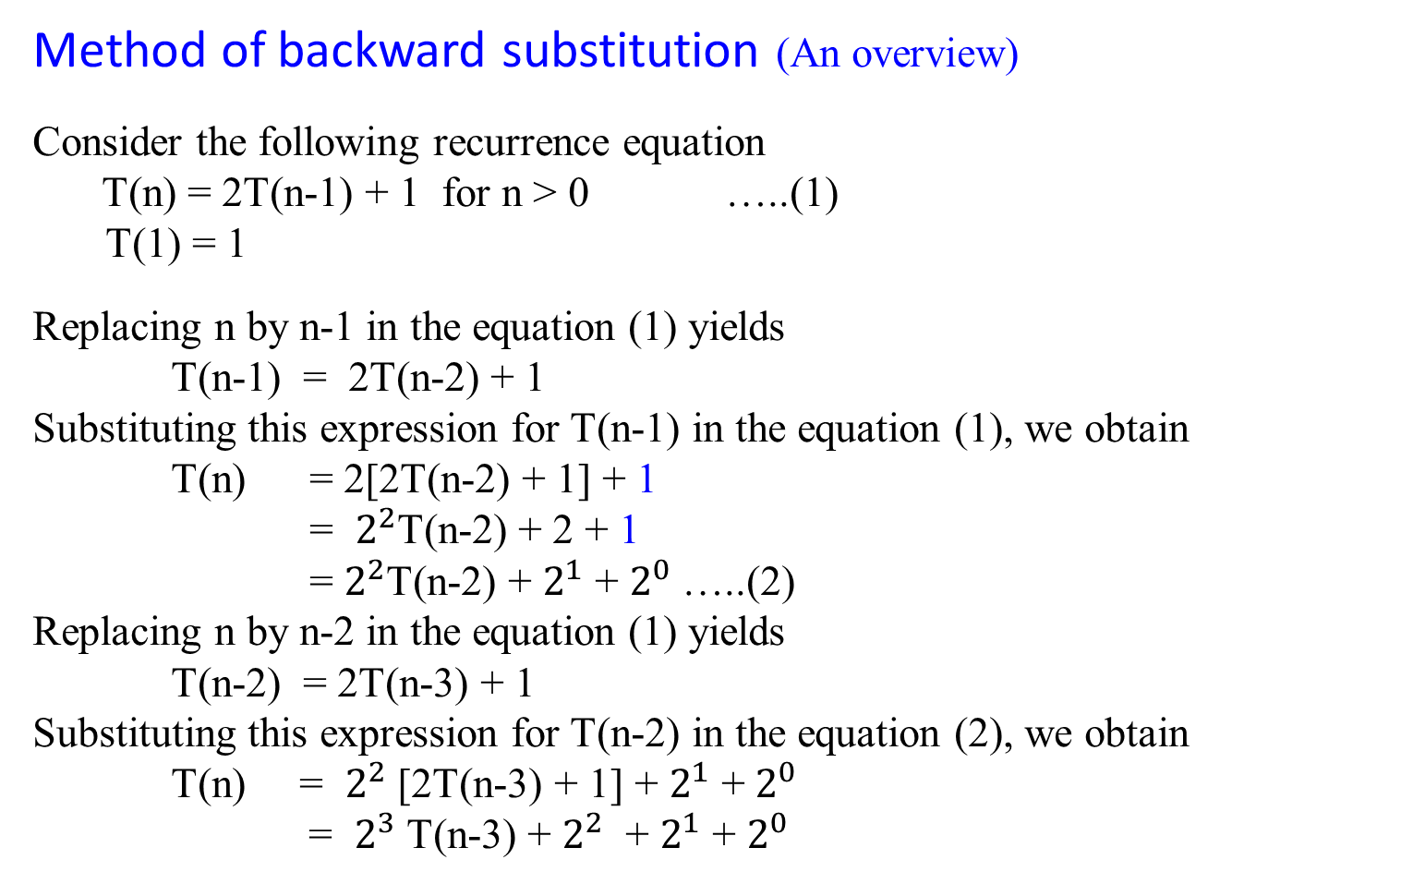
Method of backward substitution (An overview)
Consider the following recurrence equation
T(n) = 2T(n-1) + 1 for n > 0 …..(1)
T(1) = 1
Replacing n by n-1 in the equation (1) yields
T(n-1) = 2T(n-2) + 1
Substituting this expression for T(n-1) in the equation (1), we obtain
T(n) = 2[2T(n-2) + 1] + 1
= $2^{2}$T(n-2) + 2 + 1
= $2^{2}$T(n-2) + $2^{1}$ + $2^{0}$…..(2)
Replacing n by n-2 in the equation (1) yields
T(n-2) = 2T(n-3) + 1
Substituting this expression for T(n-2) in the equation (2), we obtain
T(n) = $2^{2}$[2T(n-3) + 1] + $2^{1}$ + $2^{0}$
= $2^{3}$T(n-3) + $2^{2}$ + $2^{1}$ + $2^{0}$

Slide 18

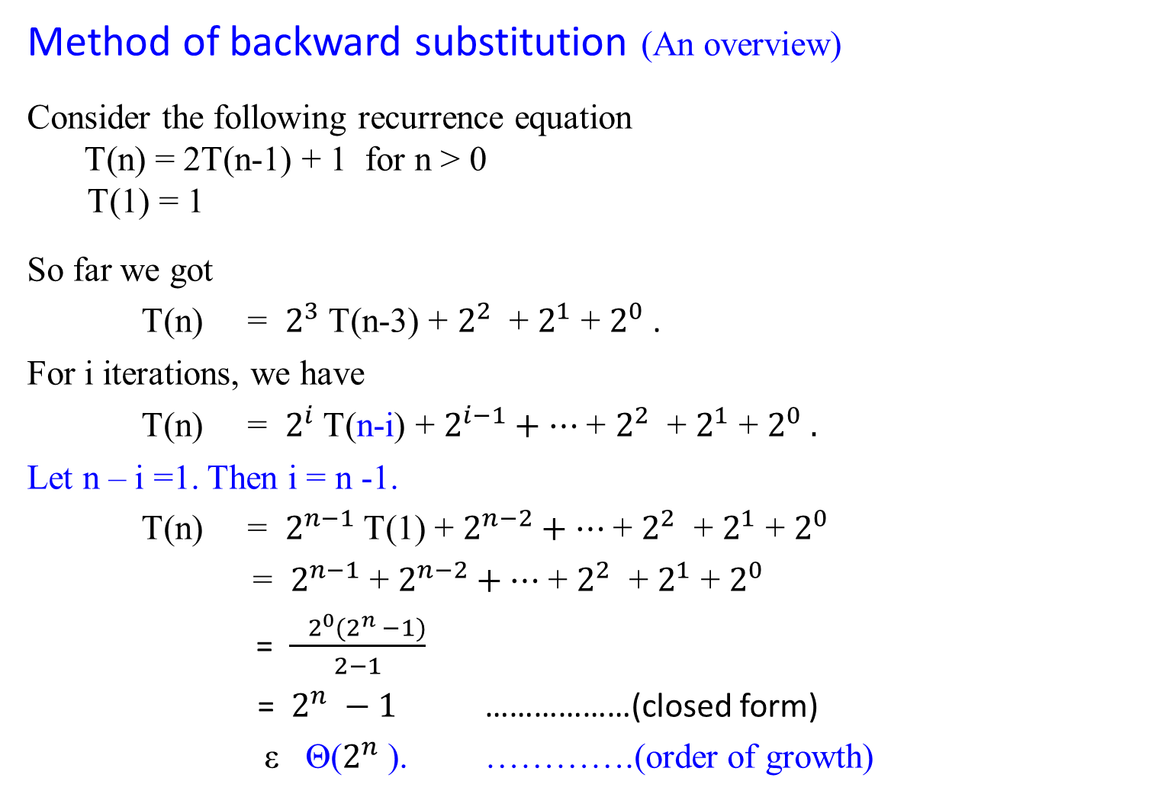

Method of backward substitution (An overview)
Consider the following recurrence equation
T(n) = 2T(n-1) + 1 for n > 0
T(1) = 1
So far we got
T(n) = $2^{3}$T(n-3) + $2^{2}$ + $2^{1}$ + $2^{0}$.
For i iterations, we have
T(n) = $2^{i}$T(n-i) + $2^{i−1}+…$+ $2^{2}$ + $2^{1}$ + $2^{0} .$
Let n – i =1. Then i = n -1.
T(n) = $2^{n−1}$T(1) + $2^{n−2}+…$+ $2^{2}$ + $2^{1}$ + $2^{0}$
= $2^{n−1}$ + $2^{n−2}+…$+ $2^{2}$ + $2^{1}$ + $2^{0}$
= $\frac{ 2^{0}(2^{n} −1)}{2−1}$
= $2^{n} −1$ ………………(closed form)
ε Θ($2^{n}$). ………….(order of growth)
The geometric series a + ar + ar² + … formula:
$$S_{n}= \frac{a(r^{n} −1)}{r −1}$$

Slide 20

Method of backward substitution (An overview)
Consider the following recurrence equation
T(n) = T(n-1) + n for n > 0 …..(1)
T(0) = 0
Replacing n by n-1 in the equation (1) yields
T(n-1) = T(n-2) + n - 1
Substituting this expression for T(n-1) in the equation (1), we obtain
T(n) = [T(n-2) + n-1] + n
= T(n-2) +(n-1) + n …..(2)
Replacing n by n-2 in the equation (1) yields
T(n-2) = T(n-3) + n-2
Substituting this expression for T(n-2) in the equation (2), we obtain
T(n) = [T(n-3) + n-2 ] + (n-1) + n
= T(n-3) + (n-2) + (n-1) + n

Slide 21

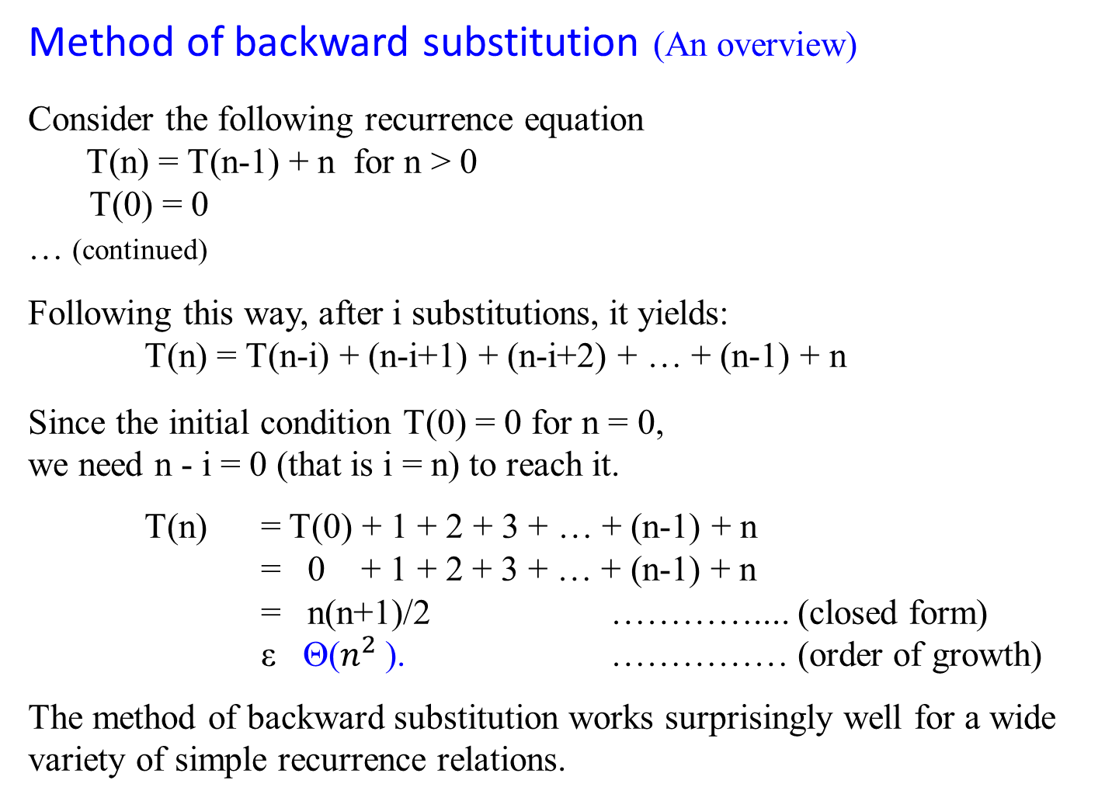
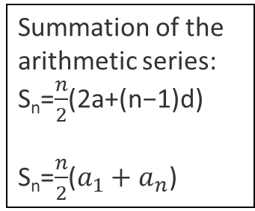
Method of backward substitution (An overview)
Consider the following recurrence equation
T(n) = T(n-1) + n for n > 0
T(0) = 0
… (continued)
Following this way, after i substitutions, it yields:
T(n) = T(n-i) + (n-i+1) + (n-i+2) + … + (n-1) + n
Since the initial condition T(0) = 0 for n = 0,
we need n - i = 0 (that is i = n) to reach it.
T(n) = T(0) + 1 + 2 + 3 + … + (n-1) + n
= 0 + 1 + 2 + 3 + … + (n-1) + n
= n(n+1)/2 ………….... (closed form)
ε Θ($n^{2}$). …………… (order of growth)
The method of backward substitution works surprisingly well for a wide variety of simple recurrence relations.
T(1) = T(0) + 1 = 1;
T(2) = T(1) + 2 = 1 + 2 = 3;
T(3) = T(2) + 3 = 2 + 3 = 6
T(4) = T(3) + 4 = 6 +4 = 10
T(5) = T(4) + 5 = 10 + 5 =15
T(6) = T(5) + 6 = 15 + 6 = 21
T(n) = 0 + 1 + 3 + 6 + 10 + 15 + 21 + 28 + 36 + 45 + …
T(n) = ?
Answer: T(n) = $\frac{n(n+1)}{2}$
Is this easy to conclude it?
Summation of the arithmetic series:
S_{n}=$\frac{n}{2}$(2a+(n−1)d)
S_{n}=$\frac{n}{2}$($a_{1}+a_{n}$)

Slide 22

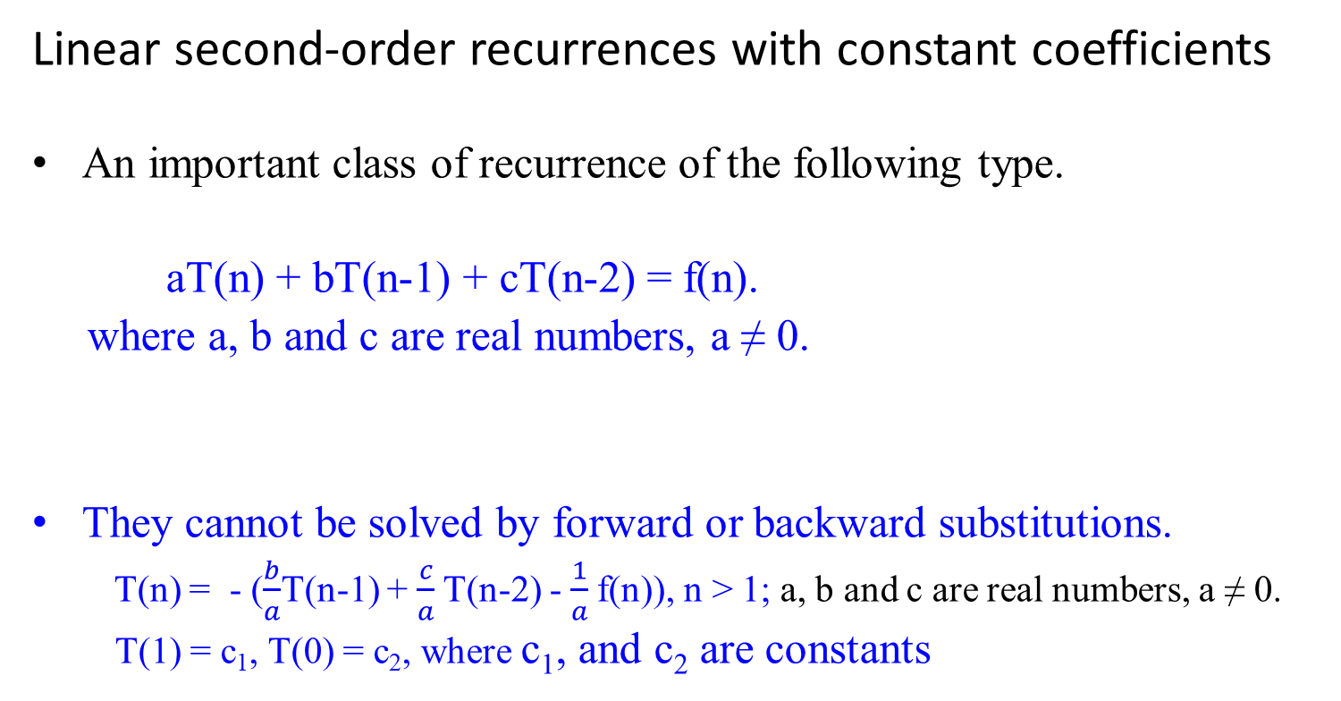
Linear second-order recurrences with constant coefficients
An important class of recurrence of the following type.
aT(n) + bT(n-1) + cT(n-2) = f(n).
where a, b and c are real numbers, a ≠ 0.
They cannot be solved by forward or backward substitutions.
T(n) = - ($\frac{b}{a}$T(n-1) + $\frac{c}{a}$T(n-2) - $\frac{1}{a}$f(n)), n > 1; a, b and c are real numbers, a ≠ 0.
T(1) = c₁, T(0) = c₂, where c₁, and c₂ are constants

Slide 23

Linear second-order recurrences with constant coefficients
aT(n) + bT(n-1) + cT(n-2) = f(n)
where a, b and c are real numbers, a ≠ 0.
The recurrence is:
second-order because the elements T(n) and T(n-2) are two positions apart in the unknown sequence in questions.
linear because the left-hand side is a linear combination of the unknown terms of the sequence.
constant coefficients where a, b, and c are assumed to be some fixed number.
homogeneous, if f(n) = 0 for every n; otherwise, it is called inhomogeneous.
This recurrence is called second-order linear recurrence with constant coefficients.

Slide 24

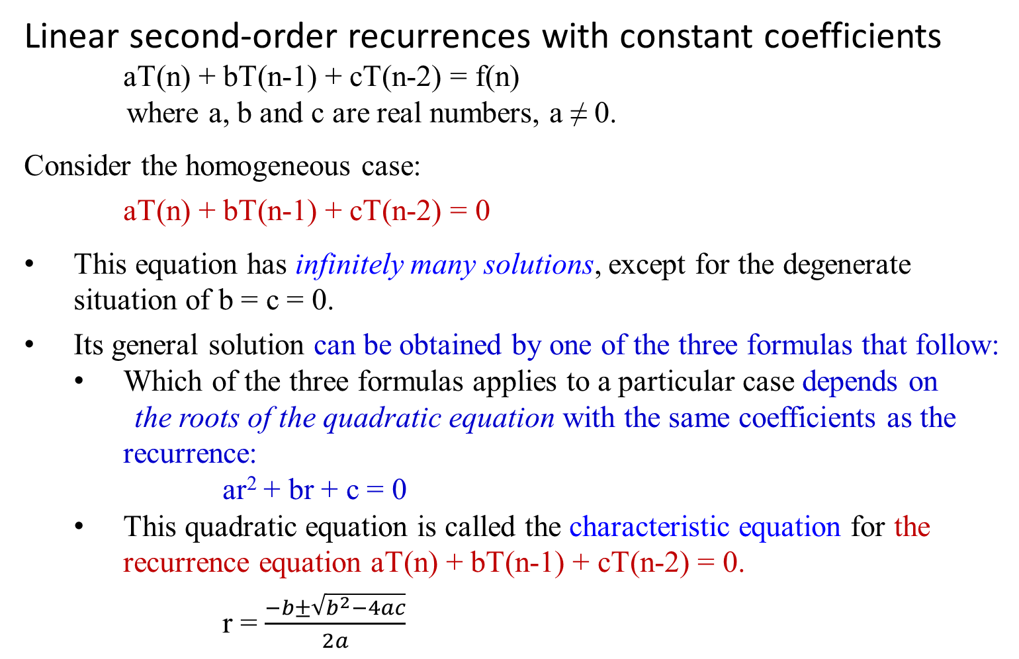
Linear second-order recurrences with constant coefficients
aT(n) + bT(n-1) + cT(n-2) = f(n)
where a, b and c are real numbers, a ≠ 0.
Consider the homogeneous case:
aT(n) + bT(n-1) + cT(n-2) = 0
This equation has infinitely many solutions, except for the degenerate situation of b = c = 0.
Its general solution can be obtained by one of the three formulas that follow:
Which of the three formulas applies to a particular case depends on
the roots of the quadratic equation with the same coefficients as the recurrence:
ar² + br + c = 0
This quadratic equation is called the characteristic equation for the recurrence equation aT(n) + bT(n-1) + cT(n-2) = 0.
r = $\frac{−b±\sqrt{b^{2}−4ac}}{2a}$

Slide 25

Theorem 1.4: Let r₁, r₂ be two roots of characteristic equation
ar² + br + c = 0
for recurrence relation aT(n) + bT(n-1) + cT(n-2) = 0.
Case 1: If r₁ and r₂ are real and distinct, the general solution to the recurrence relation is obtained by the formula
T(n) = α r₁^{n} + β r₂^{n}
where α and β are two arbitrary real constants.
Case 2: …

Slide 26

Theorem 1.4: Let r₁, r₂ be two roots of characteristic equation
ar² + br + c = 0
for recurrence relation aT(n) + bT(n-1) + cT(n-2) = 0.
Case 1: …
Case 2: If r₁ and r₂ are equal to each other, the general solution to
the recurrence relation is obtained by the formula
T(n) = α r^{n} + β n r^{n}
where r = r₁ = r₂, and α and β are two arbitrary real constants.
Case 3: …

Slide 27
Theorem 1.4: Let r₁, r₂ be two roots of characteristic equation
ar² + br + c = 0
for recurrence relation aT(n) + bT(n-1) + cT(n-2) = 0.
Case 1: ..
Case 2: …
Case 3: If r_{1, 2} = u + i v are two distinct complex numbers, the
general solution to the recurrence relation is obtained by the
formula
T(n) = γ^{n}[α cos nθ + β sin nθ]
where γ = √(u² + v²) and θ = arctan v/u, and α and β are
two arbitrary real constants.

Slide 28

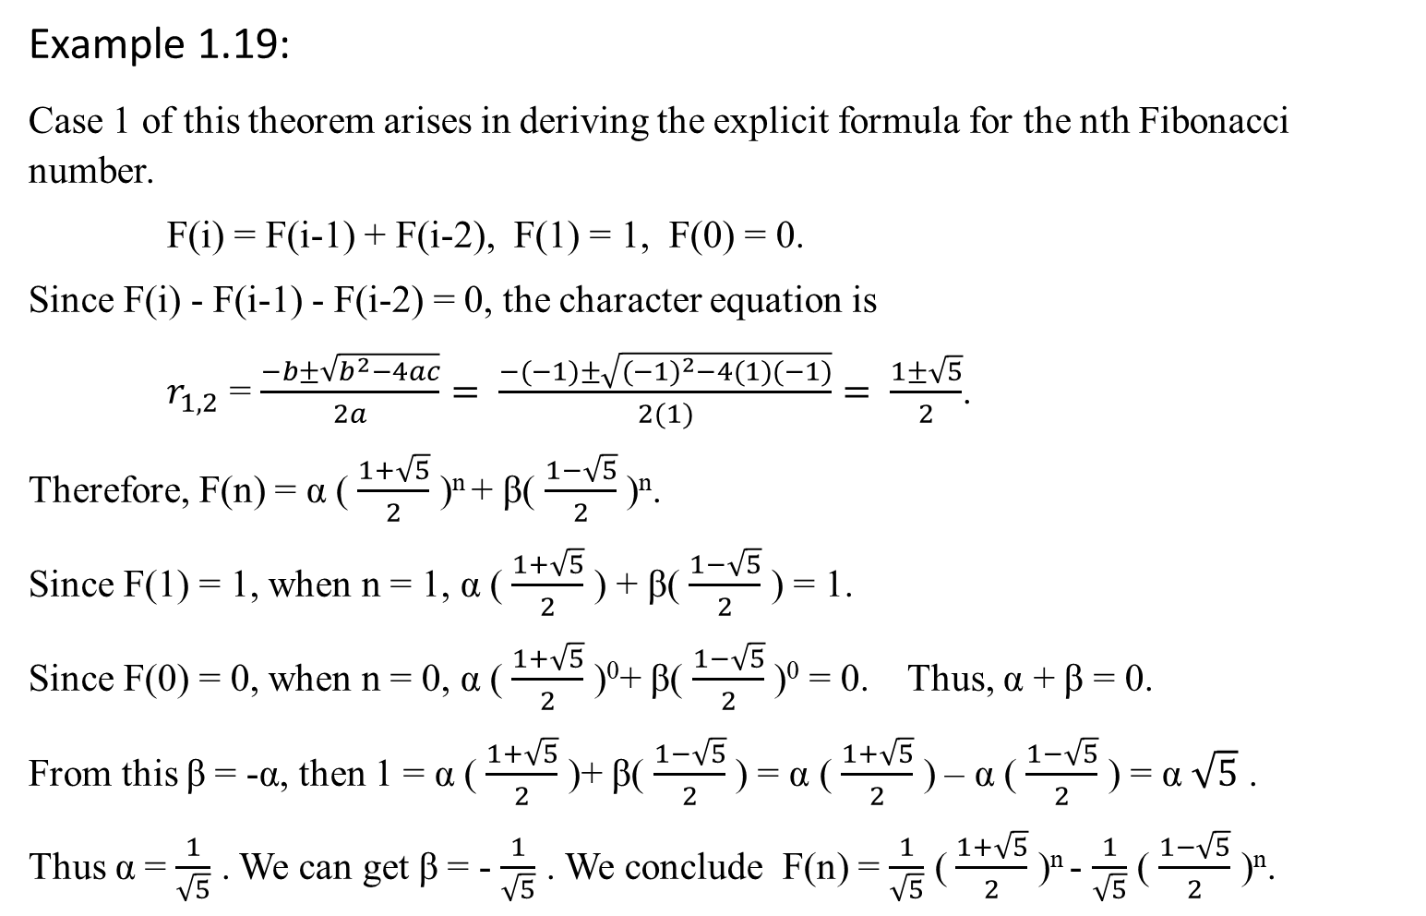
Example 1.19:
Case 1 of this theorem arises in deriving the explicit formula for the nth Fibonacci number.
F(i) = F(i-1) + F(i-2), F(1) = 1, F(0) = 0.
Since F(i) - F(i-1) - F(i-2) = 0, the character equation is
$r_{1,2}$ = $\frac{−b±\sqrt{b^{2}−4ac}}{2a}= \frac{−(−1)±\sqrt{{(−1)}^{2}−4(1)(−1)}}{2(1)}= \frac{1±\sqrt{5}}{2}$.
Therefore, F(n) = α ( $\frac{1+\sqrt{5}}{2}$ )^{n} + β( $\frac{1−\sqrt{5}}{2}$ )^{n}.
Since F(1) = 1, when n = 1, α ( $\frac{1+\sqrt{5}}{2}$ ) + β( $\frac{1−\sqrt{5}}{2}$ ) = 1.
Since F(0) = 0, when n = 0, α ( $\frac{1+\sqrt{5}}{2}$ )⁰+ β( $\frac{1−\sqrt{5}}{2}$ )⁰ = 0. Thus, α + β = 0.
From this β = -α, then 1 = α ( $\frac{1+\sqrt{5}}{2}$ )+ β( $\frac{1−\sqrt{5}}{2}$ ) = α ( $\frac{1+\sqrt{5}}{2}$ ) – α ( $\frac{1−\sqrt{5}}{2}$ ) = α $\sqrt{5}$ .
Thus α = $\frac{1}{\sqrt{5}}$ . We can get β = - $\frac{1}{\sqrt{5}}$ . We conclude F(n) = $\frac{1}{\sqrt{5}}$ ( $\frac{1+\sqrt{5}}{2}$ )^{n} - $\frac{1}{\sqrt{5}}$ ( $\frac{1−\sqrt{5}}{2}$ )^{n}.

Slide 29
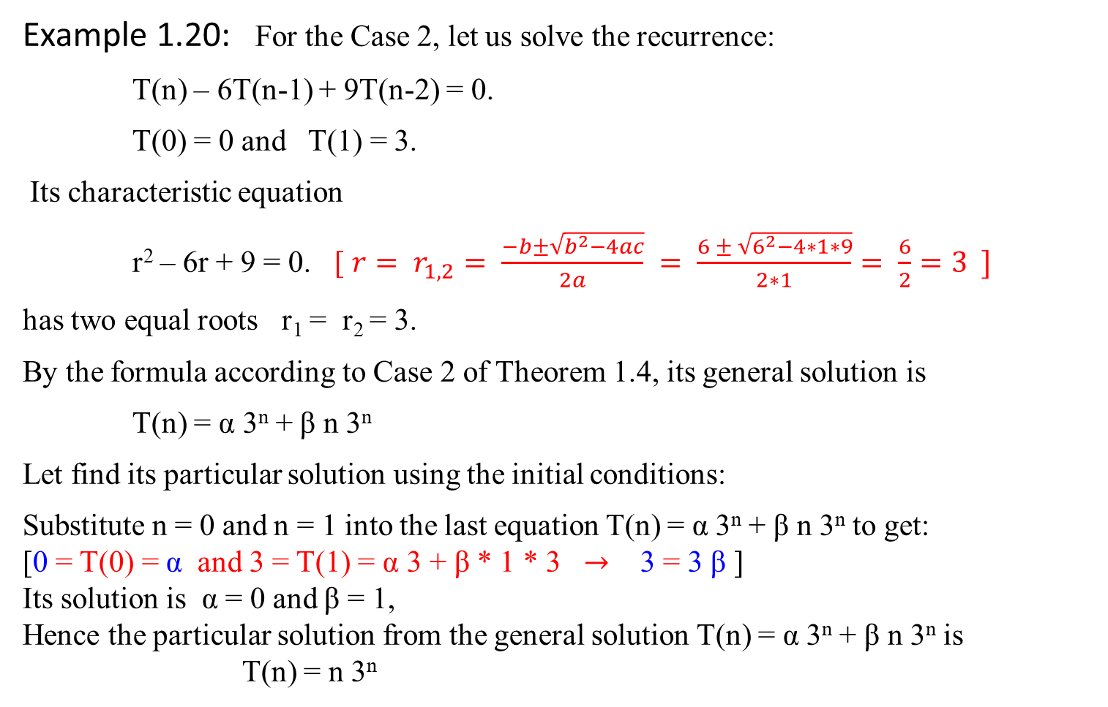
Example 1.20: For the Case 2, let us solve the recurrence:
T(n) – 6T(n-1) + 9T(n-2) = 0.
T(0) = 0 and T(1) = 3.
Its characteristic equation
r² – 6r + 9 = 0. [ ${r= r}_{1,2}= \frac{−b±\sqrt{b^{2}−4ac}}{2a} = \frac{6 ± \sqrt{6^{2}−4∗1∗9}}{2∗1}= \frac{6}{2}=3 ]$
has two equal roots r₁ = r₂ = 3.
By the formula according to Case 2 of Theorem 1.4, its general solution is
T(n) = α 3^{n} + β n 3^{n}
Let find its particular solution using the initial conditions:
Substitute n = 0 and n = 1 into the last equation T(n) = α 3^{n} + β n 3^{n} to get:
[0 = T(0) = α and 3 = T(1) = α 3 + β * 1 * 3 $→$ 3 = 3 β ]
Its solution is α = 0 and β = 1,
Hence the particular solution from the general solution T(n) = α 3^{n} + β n 3^{n} is
T(n) = n 3^{n}

Slide 30
Now consider the case of inhomogeneous linear second-order recurrences with constant coefficients.
Theorem 1.5 The general solution to inhomogeneous equation
aT(n) + bT(n-1) + cT(n-2) = f(n)
can be obtained as the sum of the general solution to the corresponding homogeneous equation
aT(n) + bT(n-1) + cT(n-2) = 0
and a particular solution to inhomogeneous equation
aT(n) + bT(n-1) + cT(n-2) = f(n).
Note: Specifically, if f(n) is a nonzero constant, we can look for a particular solution that is a constant as well.

Slide 31


Example 1.21: Find the general solution to the inhomogeneous recurrence
T(n) – 6T(n-1) + 9T(n-2) = 4.
If T(n) = c is its particular solution, constant c must satisfy the above equation
c – 6c + 9c = 4,
which yields c = 1.
The homogeneous equation T(n) – 6T(n-1) + 9T(n-2) = 0
has the general solution,
T(n) = α 3^{n} + β n 3^{n} .
The particular solution to T(n) – 6T(n-1) + 9T(n-2) = 4 is obtained by the formula
T(n) = α 3^{n} + β n 3^{n} + 1.
r = $\frac{−b±\sqrt{b^{2}−4ac}}{2a}$
r = $\frac{6±\sqrt{6^{2}−4∗9}}{2}$
r_{1,2} = 3 (case 2 applied)
What if T(n) – 6T(n-1) + 9T(n-2) = f(n)?

Slide 32

Mathematical Analysis of Recursive Algorithms
Let treat Fibonacci Numbers Recurrence System as homogenous linear second-ordered recurrence with constant coefficients way.
Example 1.23: Fibonacci Numbers
Let rewrite the exponential algorithm function fib1(n) as follows:
Algorithm Fibonacci_Number F(n)
//Using its definition, computes the nth Fibonacci number recursively.
Input: A nonnegative integer n = {0, 1, 2, 3, …, n}
Output: The nth Fibonacci number
if (n ≤ 1) return n;
else return F(n-1) + F(n-2);

Slide 33
Explicit Formula for the nth Fibonacci Number
Given the recurrence
F(n) = F(n-1) + F(n-2) for n > 1
(i.e., F(n) - F(n-1) - F(n-2) = 0, for n > 1)
and two initial conditions
F(0) = 0, F(1) = 1

Slide 34
According to Theorem 1.4, this recurrence
aT(n) + bT(n-1) + cT(n-2) = 0
has an infinite number of solutions that can be obtained by one of the three formulas, depending on the number of real roots of the quadratic equation with the same coefficients as this recurrence:
ar² + br + c = 0
This equation ar² + br + c = 0 is called the characteristic equation for the recurrence aT(n) + bT(n-1) + cT(n-2) = 0.

Slide 35

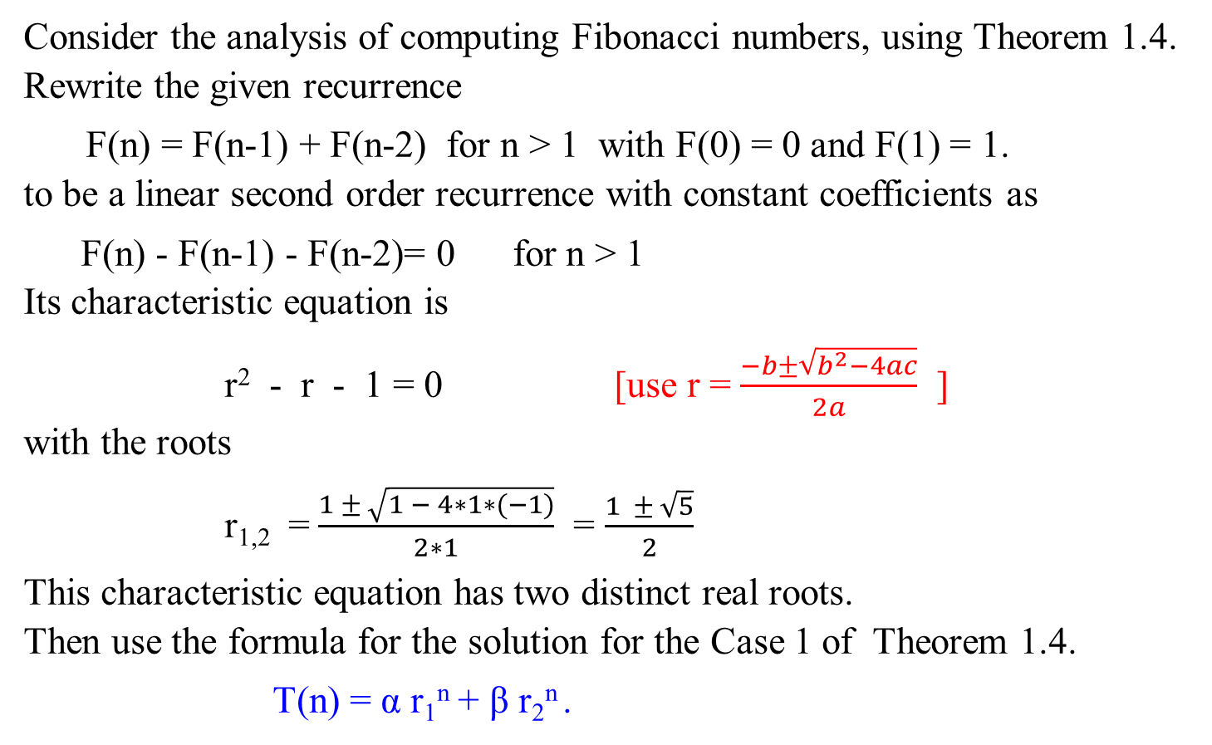
The following is stated in Example 1.19:
Consider the analysis of computing Fibonacci numbers, using Theorem 1.4.
Rewrite the given recurrence
F(n) = F(n-1) + F(n-2) for n > 1 with F(0) = 0 and F(1) = 1.
to be a linear second order recurrence with constant coefficients as
F(n) - F(n-1) - F(n-2)= 0 for n > 1
Its characteristic equation is
r² - r - 1 = 0 [use r = $\frac{−b±\sqrt{b^{2}−4ac}}{2a}$ ]
with the roots
r_{1,2} = $\frac{1 ± \sqrt{1 − 4∗1∗(−1)}}{2∗1}$ = $\frac{1 ± \sqrt{5}}{2}$
This characteristic equation has two distinct real roots. Then use the formula for the solution for the Case 1 of Theorem 1.4.
T(n) = α r₁^{n} + β r₂^{n} .

Slide 36
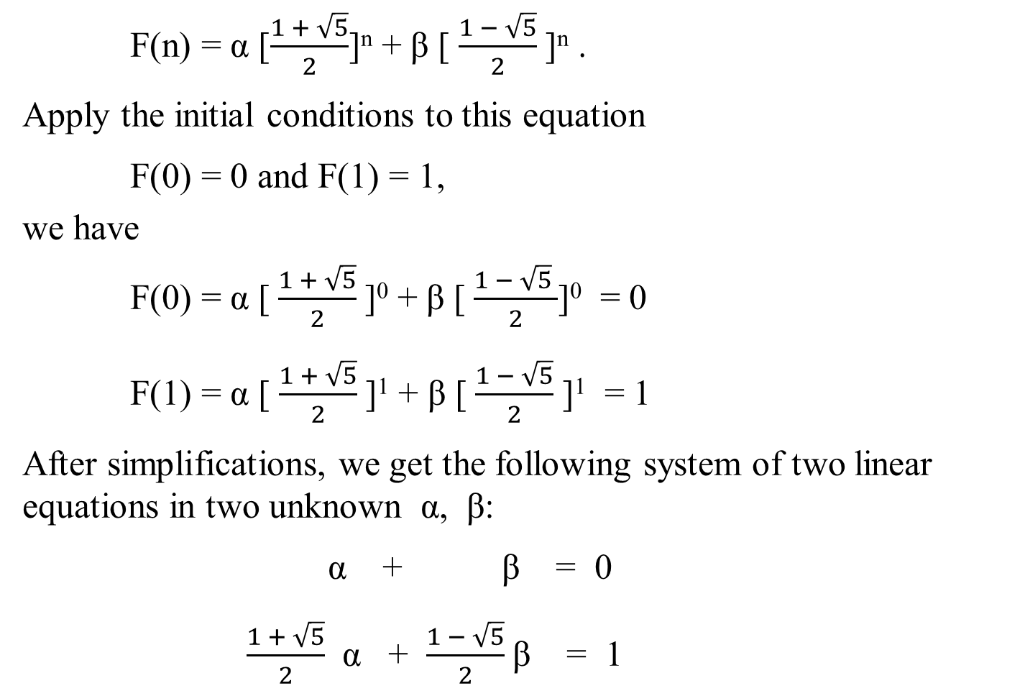
F(n) = α [$\frac{1 + \sqrt{5}}{2}$]^{n} + β [ $\frac{1 − \sqrt{5}}{2}$]^{n} .
Apply the initial conditions to this equation
F(0) = 0 and F(1) = 1,
we have
F(0) = α [$\frac{1 + \sqrt{5}}{2}$]⁰ + β [$\frac{1 − \sqrt{5} }{2}$]⁰ = 0
F(1) = α [ $\frac{1 + \sqrt{5}}{2}$]¹ + β [$\frac{1 − \sqrt{5}}{2}$ ]¹ = 1
After simplifications, we get the following system of two linear equations in two unknown α, β:
α + β = 0
$\frac{1 + \sqrt{5}}{2}$ α + $\frac{1 − \sqrt{5}}{2}$β = 1
Case 1: T(n) = α r₁^{n} + β r₂^{n}

Slide 37
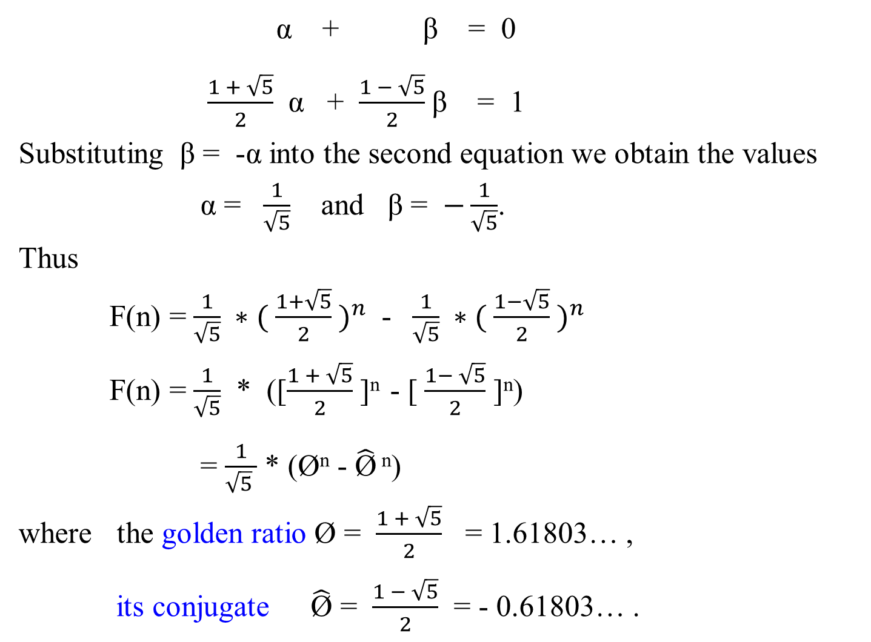
α + β = 0
$\frac{1 + \sqrt{5}}{2}$ α + $\frac{1 − \sqrt{5}}{2}$β = 1
Substituting β = -α into the second equation we obtain the values
α = $\frac{1}{\sqrt{5}}$ and β = $−\frac{1}{\sqrt{5}}$.
Thus
F(n) = $\frac{1}{\sqrt{5}} ∗( \frac{1+\sqrt{5}}{2} )^{n}$ - $\frac{1}{\sqrt{5}} ∗( \frac{1−\sqrt{5}}{2} )^{n}$
F(n) = $\frac{1}{\sqrt{5}}$ * ([$\frac{1 + \sqrt{5}}{2}$]^{n} - [$\frac{1− \sqrt{5}}{2}$ ]^{n})
= $\frac{1}{\sqrt{5} }$ * (Ø^{n} - $\hat{\text{Ø}}$ ^{n})
where the golden ratio Ø = $\frac{1 + \sqrt{5}}{2}$ = 1.61803… ,
its conjugate $\hat{\text{Ø}}$ = $\frac{1 − \sqrt{5}}{2}$ = - 0.61803… .

Slide 38

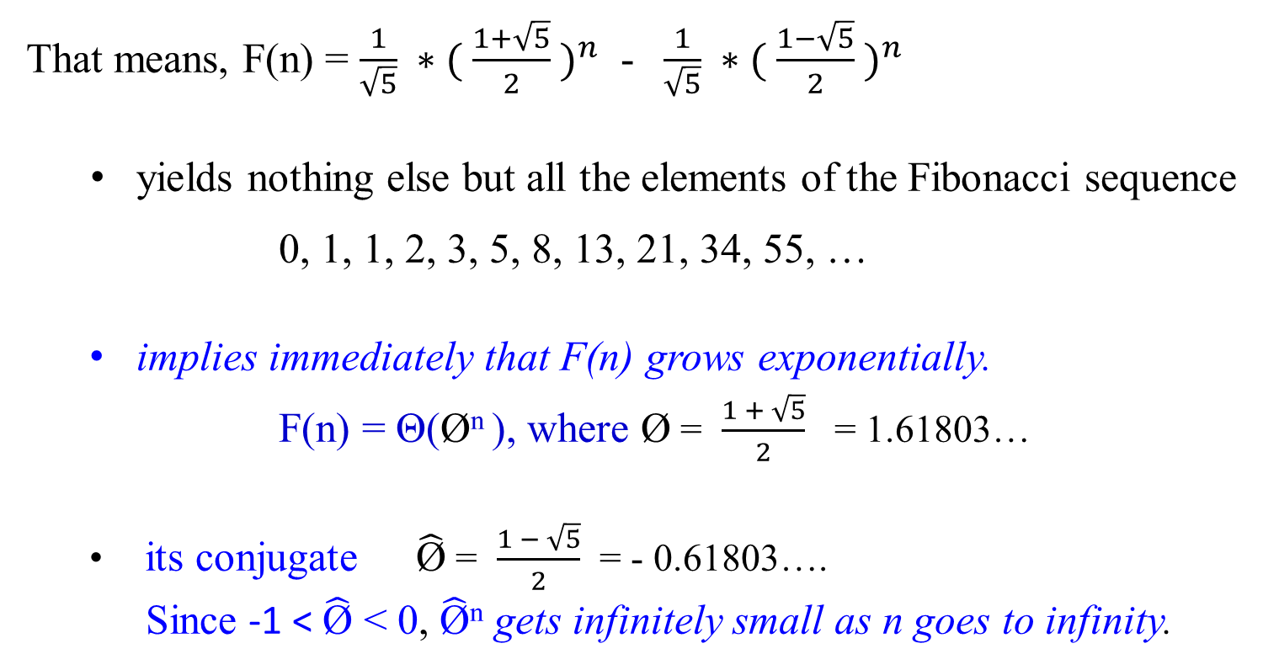
That means, F(n) = $\frac{1}{\sqrt{5}} ∗( \frac{1+\sqrt{5}}{2} )^{n}$ - $\frac{1}{\sqrt{5}} ∗( \frac{1−\sqrt{5}}{2} )^{n}$
yields nothing else but all the elements of the Fibonacci sequence
0, 1, 1, 2, 3, 5, 8, 13, 21, 34, 55, …
implies immediately that F(n) grows exponentially.
F(n) = Θ(Ø^{n} ), where Ø = $\frac{1 + \sqrt{5}}{2}$ = 1.61803…
its conjugate $\hat{\text{Ø}}$ = $\frac{1 − \sqrt{5}}{2}$ = - 0.61803….
Since -1 <$\hat{\text{Ø}}$ < 0, $\hat{\text{Ø}}$^{n} gets infinitely small as n goes to infinity.

Slide 39
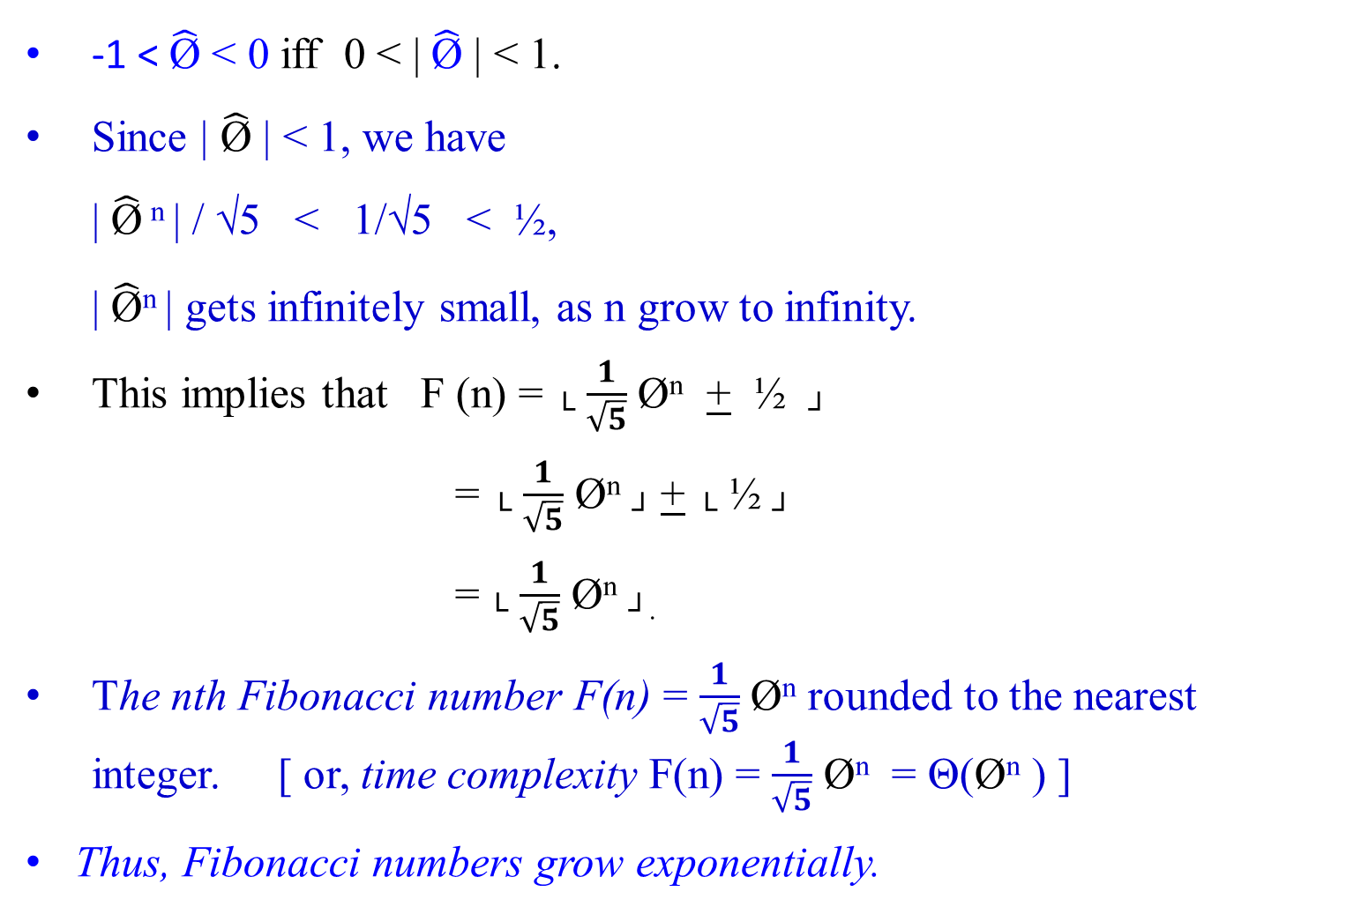
-1 <$\hat{\text{Ø}}$ < 0 iff 0 < | $\hat{\text{Ø}}$ | < 1.
Since | $\hat{\text{Ø}}$ | < 1, we have
| $\hat{\text{Ø}}$ ^{n} | / √5 < 1/√5 < ½,
| $\hat{\text{Ø}}$^{n} | gets infinitely small, as n grow to infinity.
This implies that F (n) = └ $\frac{1}{\sqrt{5}}$ Ø^{n} + ½ ┘
= └ $\frac{1}{\sqrt{5}}$ Ø^{n} ┘ + └ ½ ┘
= └ $\frac{1}{\sqrt{5}}$ Ø^{n} ┘.
The nth Fibonacci number F(n) = $\frac{1}{\sqrt{5}}$ Ø^{n} rounded to the nearest integer. [ or, time complexity F(n) = $\frac{1}{\sqrt{5}}$ Ø^{n} = Θ(Ø^{n} ) ]
Thus, Fibonacci numbers grow exponentially.

Slide 40

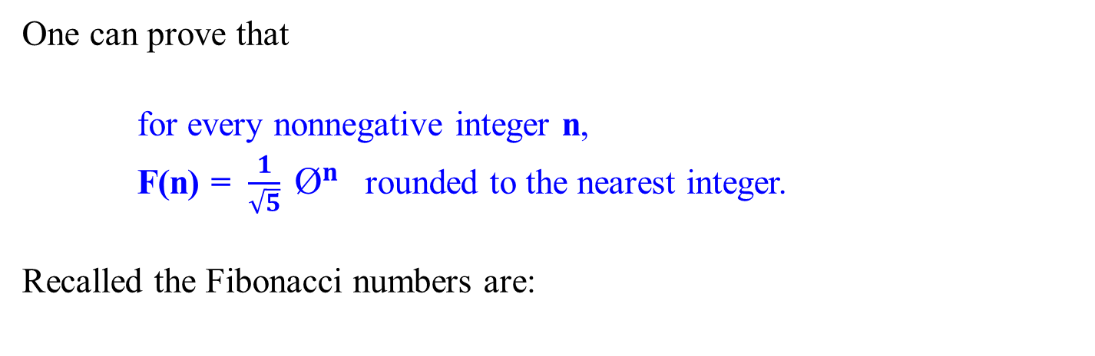
One can prove that
for every nonnegative integer n,
F(n) = $\frac{1}{\sqrt{5}} {\text{Ø}}^{n}$ rounded to the nearest integer.
Recalled the Fibonacci numbers are:
k=0 | 1 | 2 | 3 | 4 | 5 | 6 | 7 | 8 | 9 | 10 | 11 | 12 | 13
F=0 | 1 | 1 | 2 | 3 | 5 | 8 | 13 | 21 | 34 | 54 | 88 | 142 | 230

Slide 41
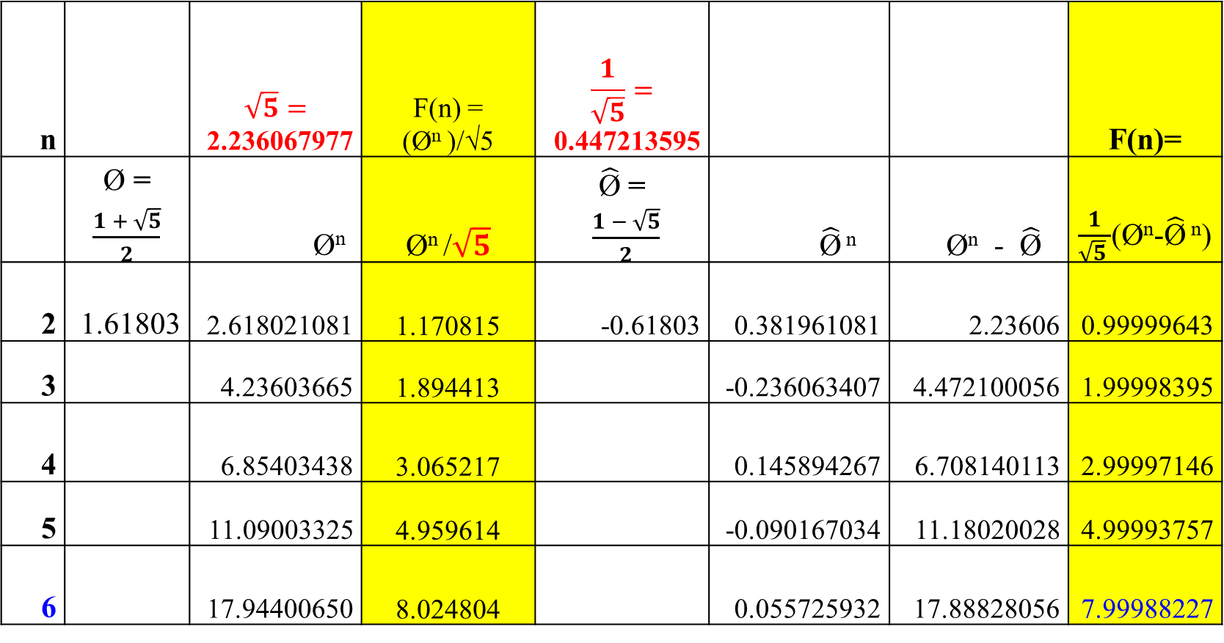
n |  | $$\sqrt{5}=$$ 2.236067977 | F(n) = (Ø^{n} )/√5 | $$\frac{1}{\sqrt{5}}=$$ 0.447213595 |  |  | F(n)=
 | Ø = $\frac{1 + \sqrt{5}}{2}$ | Ø^{n} | Ø^{n} /$\sqrt{5}$ | $\hat{\text{Ø}}$ = $\frac{1 − \sqrt{5}}{2}$ | $\hat{\text{Ø}}$ ^{n} | Ø^{n} - $\hat{\text{Ø}}$ | $\frac{1}{\sqrt{5} }$(Ø^{n}-$\hat{\text{Ø}}$ ^{n})
2 | 1.61803 | 2.618021081 | 1.170815 | -0.61803 | 0.381961081 | 2.23606 | 0.99999643
3 |  | 4.23603665 | 1.894413 |  | -0.236063407 | 4.472100056 | 1.99998395
4 |  | 6.85403438 | 3.065217 |  | 0.145894267 | 6.708140113 | 2.99997146
5 |  | 11.09003325 | 4.959614 |  | -0.090167034 | 11.18020028 | 4.99993757
6 |  | 17.94400650 | 8.024804 |  | 0.055725932 | 17.88828056 | 7.99988227
k=0 | 1 | 2 | 3 | 4 | 5 | 6 | 7 | 8 | 9 | 10 | 11 | 12 | 13
F=0 | 1 | 1 | 2 | 3 | 5 | 8 | 13 | 21 | 34 | 55 | 89 | 144 | 233

Slide 42
Mathematical Analysis of Recursive Algorithms
Another Method for Solving inhomogeneous Recurrence Relation
of Given Recursive Fibonacci Numbers Algorithm

Slide 43

Recall that we have treated Fibonacci Numbers Recurrence System as a homogenous linear second-ordered recurrence with constant coefficients way.
Example 1.23: Fibonacci Numbers
Let rewrite the exponential algorithm function Fib1(n) as follows:
Algorithm Fibonacci_Number Fib1(n)
//Use its definition to compute the nth Fibonacci number recursively. Input: A nonnegative integer n
Output: The nth Fibonacci number
if (n ≤ 1) return n;
else return Fib1(n-1) + Fib1(n-2);

Slide 44


A(n) – A(n-1) – A(n-2) = 0
r² - r - 1 = 0
Using case 2, A(n) = [(Ø ^{n} - $\hat{\text{Ø}}$^{n})/ √5].
Let A(c) = c.
c – c – c = 1
c = 1
c = -1
A(n) = [(Ø ^{n} - $\hat{\text{Ø}}$^{n})/ √5] - 1.
Analysis of the Algorithm
Consider that Algorithm Fibonacci_Number Fib1(n)
if n ≤ 1 return n
else return Fib1(n-1) + Fib1(n-2);
Input size is the magnitude of n;
The basis operation is addition +.
Let A(n) be the number of additions performed by the algorithm in computing Fib1(n).
Then the numbers of additions needed for computing Fib1(n-1) and Fb1(n-2) are A(n-1) and A(n-2), respectively, and the algorithm needs one more addition to compute their sum. Thus,
A(n) = A(n-1) + A(n-2) + 1 for n > 1.
A(0) = 0, A(1) = 0.

Slide 45

A(n) = A(n-1) + A(n-2) + 1 for n > 1.
A(0) = 0, A(1) = 0.
This inhomogeneous recurrence
A(n) – A(n-1) – A(n-2) = 1
is quite similar to the recurrence
F(n) – F(n-1) – F(n-2) = 0,
but its right-hand side is not equal to zero.
[what are the differences between these two recurrence systems?]
[General techniques for solving inhomogeneous recurrences can be found in the section “Explicit Formula for the nth Fibonacci Number” of this copy of lecture note].

Slide 46
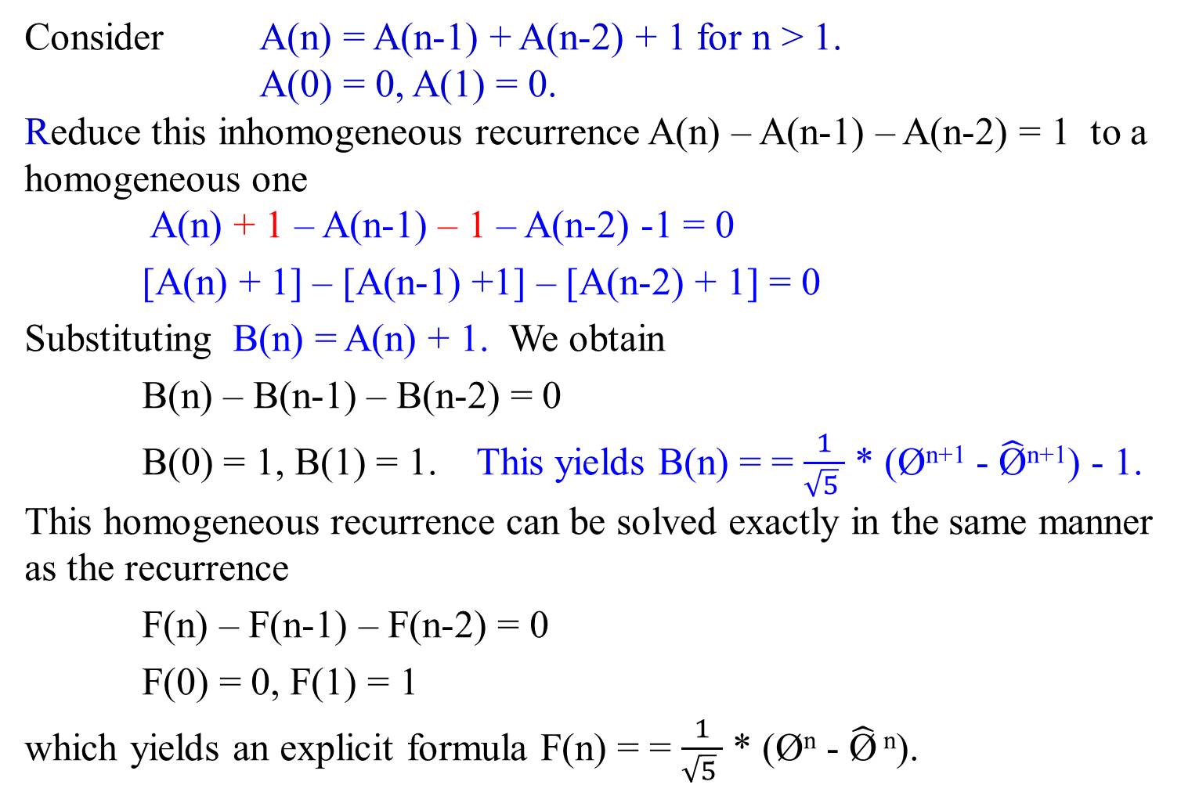
Consider A(n) = A(n-1) + A(n-2) + 1 for n > 1.
A(0) = 0, A(1) = 0.
Reduce this inhomogeneous recurrence A(n) – A(n-1) – A(n-2) = 1 to a homogeneous one
A(n) + 1 – A(n-1) – 1 – A(n-2) -1 = 0
[A(n) + 1] – [A(n-1) +1] – [A(n-2) + 1] = 0
Substituting B(n) = A(n) + 1. We obtain
B(n) – B(n-1) – B(n-2) = 0
B(0) = 1, B(1) = 1. This yields B(n) = = $\frac{1}{\sqrt{5} }$ * (Ø^{n+1} - $\hat{\text{Ø}}$^{n+1}) - 1.
This homogeneous recurrence can be solved exactly in the same manner as the recurrence
F(n) – F(n-1) – F(n-2) = 0
F(0) = 0, F(1) = 1
which yields an explicit formula F(n) = = $\frac{1}{\sqrt{5} }$ * (Ø^{n} - $\hat{\text{Ø}}$ ^{n}).

Slide 47
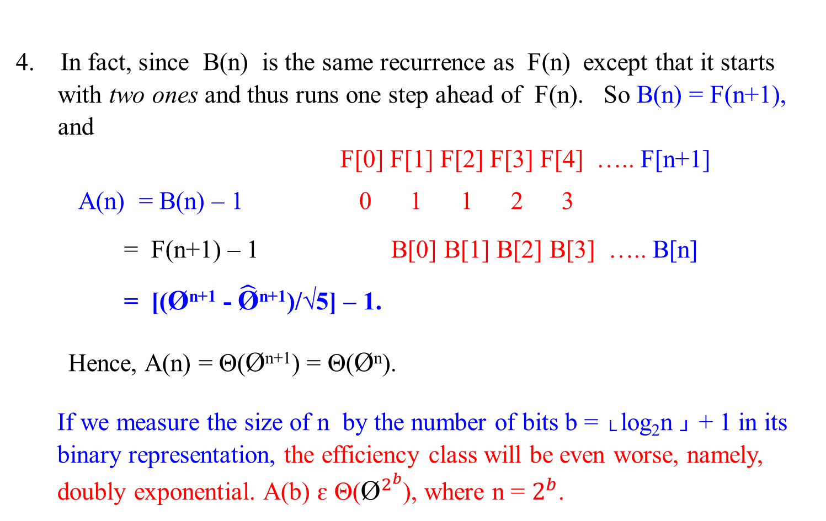
4. In fact, since B(n) is the same recurrence as F(n) except that it starts with two ones and thus runs one step ahead of F(n). So B(n) = F(n+1), and
F[0] F[1] F[2] F[3] F[4] ….. F[n+1]
A(n) = B(n) – 1 0 1 1 2 3
= F(n+1) – 1 B[0] B[1] B[2] B[3] ….. B[n]
= [(Ø^{n+1} - $\hat{\text{Ø}}$^{n+1})/√5] – 1.
Hence, A(n) = Θ(Ø^{n+1}) = Θ(Ø^{n}).
If we measure the size of n by the number of bits b = └ log₂n ┘ + 1 in its binary representation, the efficiency class will be even worse, namely, doubly exponential. A(b) ɛ Θ(${\text{Ø}}^{2^{b}}$), where n = $2^{b}$.

Slide 48
5. The poor efficiency class of the algorithm could be anticipated by the nature of recurrence. It contains two recursive calls with the sizes of smaller instances (n-1) only slightly smaller than size n.
We also can see the reason behind the algorithm’s inefficiency by looking at a recursive tree of calls tracing the algorithm’s execution. An example of such a tree for n = 5 is given as follows:

Slide 49
F(5)
F(4) F(3)
F(3) F(2) F(2) F(1)
F(2) F(1) F(1) F(0) F(1) F(0)
F(1) F(0)
Figure 1.4: The recursion tree corresponding to the exponential Algorithm Fibonacci_Number F(n).
Note that the same values of the function are being evaluated again and again, which is clearly extremely inefficient.

Slide 50
6. Let obtain a much faster algorithm by simply computing the successive elements of the Fibonacci sequence iteratively, as is done in the following algorithm.
Show that B(n) = F(n +1).
Shown: Shown by induction.
B(n) = A(n) +1
Let n = 0. Then B(0) = A(0) + 1 = 1 = F(1)
Let n = 1. B(1) = A(1) + 1 = 0 + 1 = 1 = F(2)
Let n = 2. B(2) = A(2) + 1
= A(1) + A(0) + 1 + 1
= 0 + 0 + 1 + 1 = 2 = F(3)
In general B(n) = F(n + 1).
Assume that B(n-1) = F(n) and B(n -2) = F(n-1) are correct. Then
B(n) = A(n) + 1 since A(n) = B(n) – 1
B(n) = A(n -1) + A(n -2) + 1 + 1 since A(n) = A(n-1) + A(n-2) + 1 for n > 1
B(n) = A(n – 1) + 1 + A(n -2 ) + 1
B(n) = B(n -1 ) + B(n-2), since A(n) = B(n) – 1
B(n) = F(n) + F(n -1) using our assumption that B(n-1) = F(n) is correct.
B(n) = F(n + 1)

Slide 51
Mathematical Analysis of
Other Ways for Computing Fibonacci Numbers

Slide 52

Second way: A polynomial algorithm Fib2(n)
A much faster algorithm by simply computing the successive elements of the Fibonacci sequence iteratively, as is done in the following algorithm.
Let rewrite the exponential algorithm to be function Fib2(n), which is as follows:

Slide 53
Polynomial Algorithm Fib2(n)
//Computes the nth Fibonacci number iteratively by using its definition
Input: A nonnegative integer n
Output: The nth Fibonacci number
if (n == 0) then return 0;
create an array F[0 .. n];
F[0] ← 0; F[1] ← 1;
for ( i ← 2) to n do {
F[i] ← Fib2[i-1] + Fib2[i-2];}
return F[n];

Slide 54

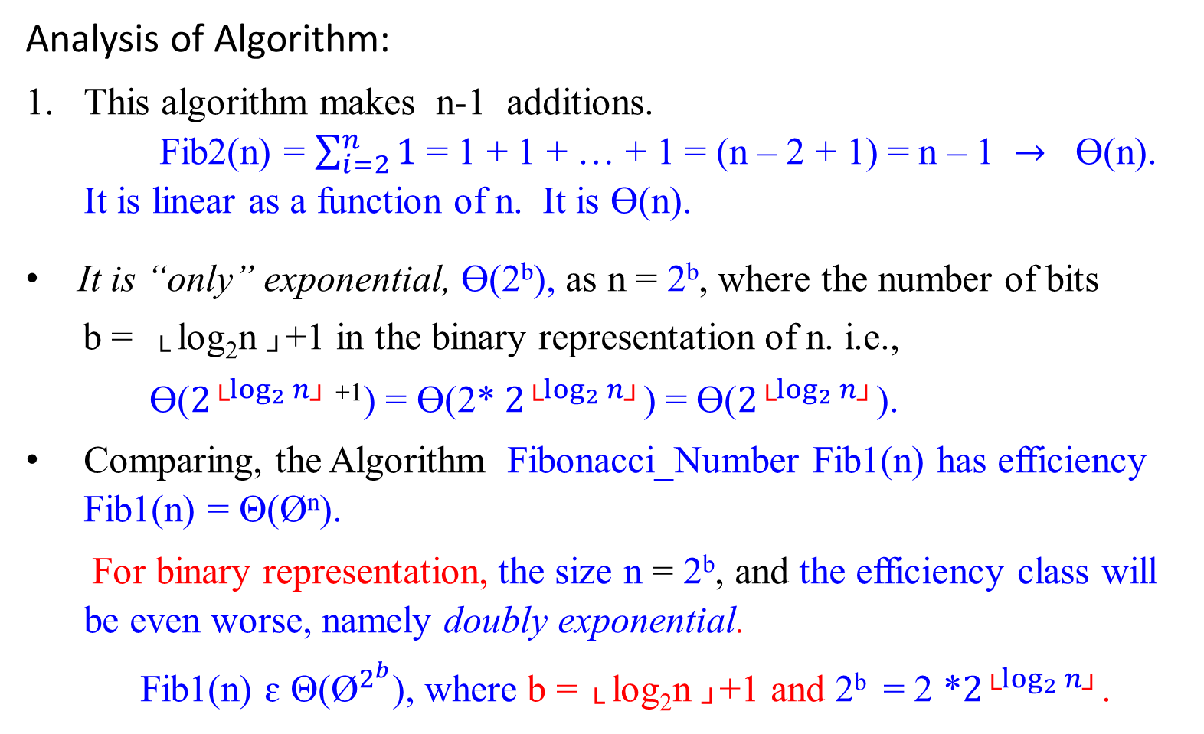
Analysis of Algorithm:
This algorithm makes n-1 additions.
Fib2(n) = $\sum_{i=2}^{n}{1}$ = 1 + 1 + … + 1 = (n – 2 + 1) = n – 1 $→$ Ɵ(n).
It is linear as a function of n. It is Ɵ(n).
It is “only” exponential, Ɵ(2^{b}), as n = 2^{b}, where the number of bits
b = └ log₂n ┘+1 in the binary representation of n. i.e.,
Ɵ($2^{{\text{└}log}_{2}{n\text{┘}}}$⁺¹) = Ɵ(2* $2^{{\text{└}log}_{2}{n\text{┘}}}$) = Ɵ($2^{{\text{└}log}_{2}{n\text{┘}}}$).
Comparing, the Algorithm Fibonacci_Number Fib1(n) has efficiency Fib1(n) = Θ(Ø^{n}).
For binary representation, the size n = 2^{b}, and the efficiency class will be even worse, namely doubly exponential.
Fib1(n) ɛ Θ(${\text{Ø}}^{2^{b}}$), where b = └ log₂n ┘+1 and 2^{b} = 2 *$2^{{\text{└}log}_{2}{n\text{┘}}}$.
: The magnitude of n

Slide 55
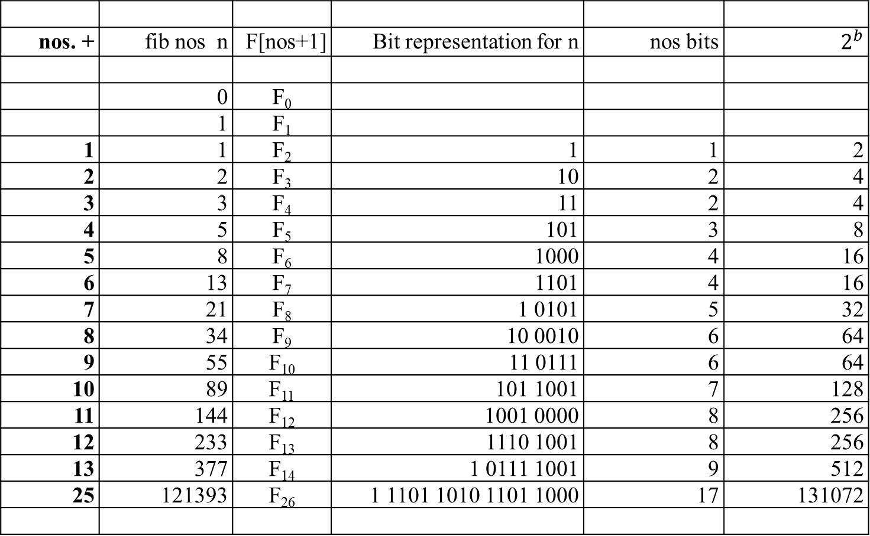
nos. + | fib nos n | F[nos+1] | Bit representation for n | nos bits | $$2^{b}$$
 | 0 | F₀
 | 1 | F₁
1 | 1 | F₂ | 1 | 1 | 2
2 | 2 | F₃ | 10 | 2 | 4
3 | 3 | F₄ | 11 | 2 | 4
4 | 5 | F₅ | 101 | 3 | 8
5 | 8 | F₆ | 1000 | 4 | 16
6 | 13 | F₇ | 1101 | 4 | 16
7 | 21 | F₈ | 1 0101 | 5 | 32
8 | 34 | F₉ | 10 0010 | 6 | 64
9 | 55 | F₁₀ | 11 0111 | 6 | 64
10 | 89 | F₁₁ | 101 1001 | 7 | 128
11 | 144 | F₁₂ | 1001 0000 | 8 | 256
12 | 233 | F₁₃ | 1110 1001 | 8 | 256
13 | 377 | F₁₄ | 1 0111 1001 | 9 | 512
25 | 121393 | F₂₆ | 1 1101 1010 1101 1000 | 17 | 131072

Slide 56
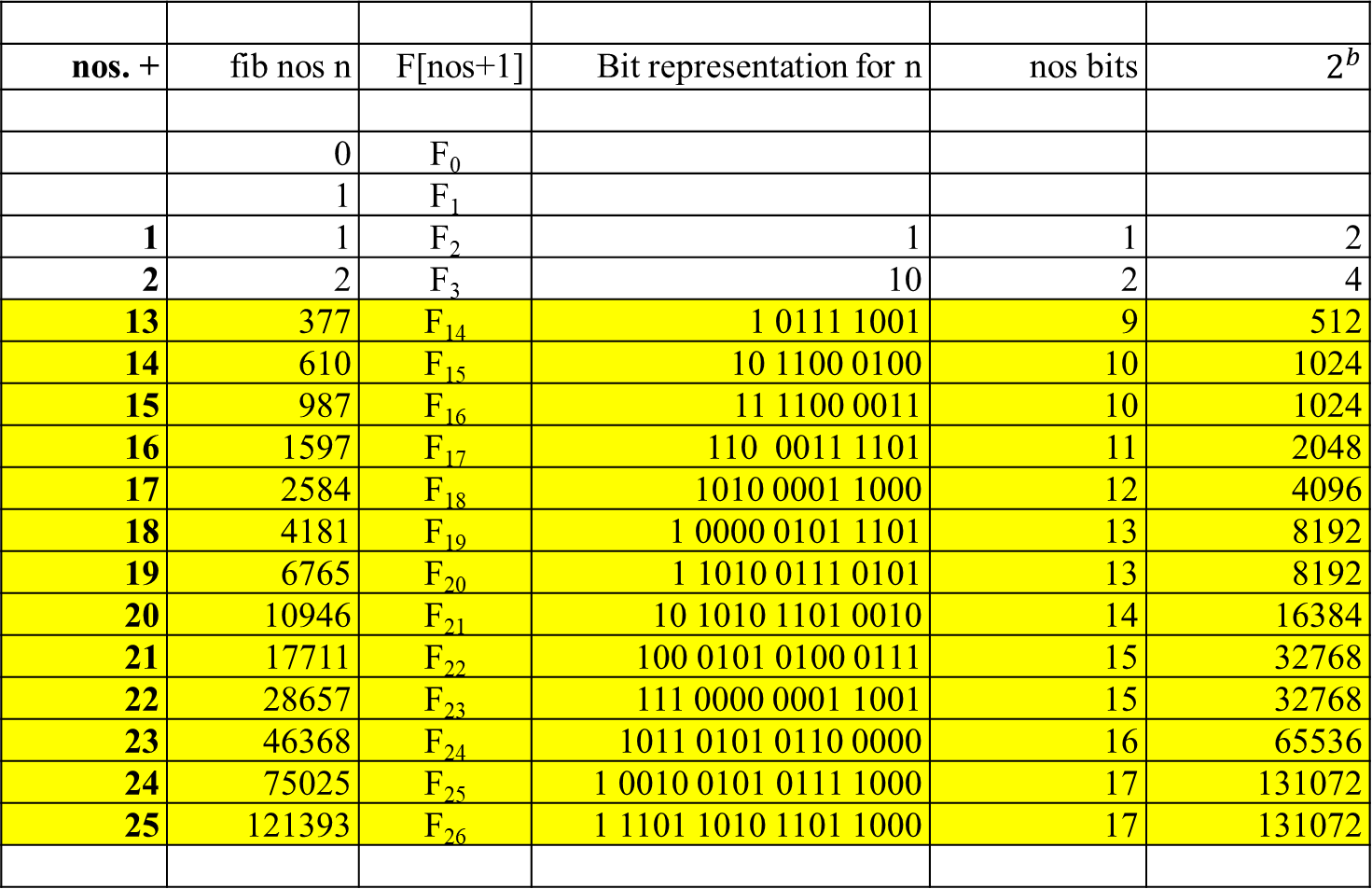
nos. + | fib nos n | F[nos+1] | Bit representation for n | nos bits | $$2^{b}$$
 | 0 | F₀
 | 1 | F₁
1 | 1 | F₂ | 1 | 1 | 2
2 | 2 | F₃ | 10 | 2 | 4
13 | 377 | F₁₄ | 1 0111 1001 | 9 | 512
14 | 610 | F₁₅ | 10 1100 0100 | 10 | 1024
15 | 987 | F₁₆ | 11 1100 0011 | 10 | 1024
16 | 1597 | F₁₇ | 110 0011 1101 | 11 | 2048
17 | 2584 | F₁₈ | 1010 0001 1000 | 12 | 4096
18 | 4181 | F₁₉ | 1 0000 0101 1101 | 13 | 8192
19 | 6765 | F₂₀ | 1 1010 0111 0101 | 13 | 8192
20 | 10946 | F₂₁ | 10 1010 1101 0010 | 14 | 16384
21 | 17711 | F₂₂ | 100 0101 0100 0111 | 15 | 32768
22 | 28657 | F₂₃ | 111 0000 0001 1001 | 15 | 32768
23 | 46368 | F₂₄ | 1011 0101 0110 0000 | 16 | 65536
24 | 75025 | F₂₅ | 1 0010 0101 0111 1000 | 17 | 131072
25 | 121393 | F₂₆ | 1 1101 1010 1101 1000 | 17 | 131072

Slide 57
Analysis of Algorithm (Continued):
Avoid using an extra array for storing all the preceding elements of the Fibonacci sequence:
storing just two values is necessary to accomplish the task.
3. The inner loop consists of a single computer step and is executed n-1 times. Therefore the number of computer steps used by Fib2 is linear in n.

Slide 58

The third alternative for computing the nth Fibonacci number lies in using a formula. For every nonnegative integer n,
F(n) = (Ø^{n} )/√5 rounded to the nearest integer,
where Ø = (1 + √5)/2 ≈ 1.61803.
Analysis of this Algorithm:
The efficiency of the algorithm will be determined by the efficiency of an exponentiation algorithm used for computing Ø^{n}.
2. But, if it is done by simply multiplying Ø by itself n-1 times, the algorithm will be in Θ(n) = Θ(2^{b} ).

Slide 59
There are faster algorithms for the exponentiation computation problem.
We will discuss Θ(log₂n) = Θ(b)-algorithms for this problem in our lectures dealing with Decrease-and-Conquer and Transform-and-Conquer.

Slide 60
The Fourth Approach for computing Fibonacci number Fib3:
There is a Θ(log₂n)-algorithm Fib3 for computing the nth Fibonacci number that manipulates only integers (not golden and conjugate ratios).
It is based on the equality
F(n-1) F(n) 0 1 ^{n}
= for n ≥ 1
F(n) F(n+1) 1 1
and an efficient way of computing matrix powers.
A question is how do you compute 2 x 2 matric powers in the fastest way.

Slide 61

Consider the equation F₁ = F₁ and F₂ = F₀ + F₁ in matrix notation:
F₁ 0 1 F₀
=
F₂ 1 1 F₁
0 F₀ + 1 F₁ F₁
= =
1 F₀ + 1 F₁ F₀ + F₁
Similarly,
F₂ 0 1 F₁ 0 1 ² F₀
= =
F₃ 1 1 F₂ 1 1 F₁

Slide 62

In general Fib3 can be expressed as:
F_{n}
0 1 ^{n} F₀
=
F_{n+1}
1 1 F₁
0 1
To compute F_{n}, it suffices to raise the 2 x 2 matrix 1 1 , call it X, to the nth power.
The question is how do you compute matrix multiplication X^{n} in O(log n).

Slide 63

a b
Consider a 2 x 2 matrix
c d
a b ² a b a b a*a + b*c a*b + b*d
= =
c d c d c d c*a + d*c c*b + d*d
Two 2 x 2 matrices can be multiplied using 4 additions and 8 multiplications.

Slide 64
a b ³ a b ² a b
=
c d c d c d
a*a + b*c a*b + b*d a b
=
c*a + d*c c*b + d*d c d
a*(a*a + b*c) + c*(a*b + b*d) b*(a*a + b*c) + d*( a*b + b*d)
=
a*( c*a + d*c) + c*(c*b + d*d) b*( c*a + d*c) + d*(c*b + d*d)
Three 2x2 matrices can be multiplied using 8 additions and 16 multiplications.

Slide 65

a b ⁴ a b ³ a b
=
c d c d c d
a*(a*a + b*c) + c*(a*b + b*d) b*(a*a + b*c) + d*( a*b + b*d) a b
=
a*( c*a + d*c) + c*(c*b + d*d) b*( c*a + d*c) + d*(c*b + d*d) c d
a*( a*(a*a + b*c) + c*(a*b + b*d)) b*( a*(a*a + b*c) + c*(a*b + b*d))
+c*(b*(a*a + b*c) + d*(a*b + b*d)) +d*(b*(a*a + b*c) + d*(a*b + b*d))
=
a*(a*(c*a + d*c) + c*(c*b + d*d)) b*(a*(c*a + d*c) + c*(c*b + d*d))
+c*(b*(c*a + d*c) + d*(c*b + d*d)) +d*(b*(c*a + d*c) + d*(c*b + d*d))
Four 2x2 matrices can be multiplied using 12 additions and 24 multiplications.

Slide 66

So far we got is that:
4 + and 8 * for two 2x2 matrices multiplications: $[ ]^{2}$
2x4 + and 2x8 * for three 2x2 matrices multiplications: $[ ]^{3}$
3x4 + and 3x8 * for four 2x2 matrices multiplications: $[ ]^{4}$
7x4 + and 7x8 * for eight 2x2 matrices multiplications: $[ ]^{8}$
In general, we have
(n-1)x4 + and (n-1)x8 * for n 2x2 matrices multiplications: $[ ]^{n}$
However, consider
X² = X X :needs 1 time of 4 + and 1 time of 8 *
X⁴ = X² X² :needs 1+1 times of 4 + and 1+1 times of 8 *
X⁸ = X^{2*4} = X⁴ X⁴ : 1+1+ 1 times of 4 + and 1+1+ 1 times of 8*: $\log_{2}{8=3}$
X¹⁶ = X^{2*8} = X⁸ X⁸ : 1+1+1+1 times of 4 + and 1+1+1+1 times of 8*: $\log_{2}{16=4}$
X³² = X^{2*16} = X¹⁶ X¹⁶ : 1+1 + 1+1+1 times of 4 + and 1+1+ 1+1+1 times of 8*: $\log_{2}{32=5}$
X⁶⁴ = X^{2*32} = X³² X³² : 1+1+1+1+1+1 times of 4 + and 1+1+1+1+1+1 times of 8*
32 = 2⁵ log 32 = log 2⁵ = 5 . i.e., X³² needs 5 times of 4 + and 8 * each. $\log_{2}{32=5}$
64 = 2⁶ log 64 = log 2⁶ = 6 . i.e., X⁶⁴ needs 6 times of 4 + and 8 * each. $\log_{2}{64=6}$

Slide 67
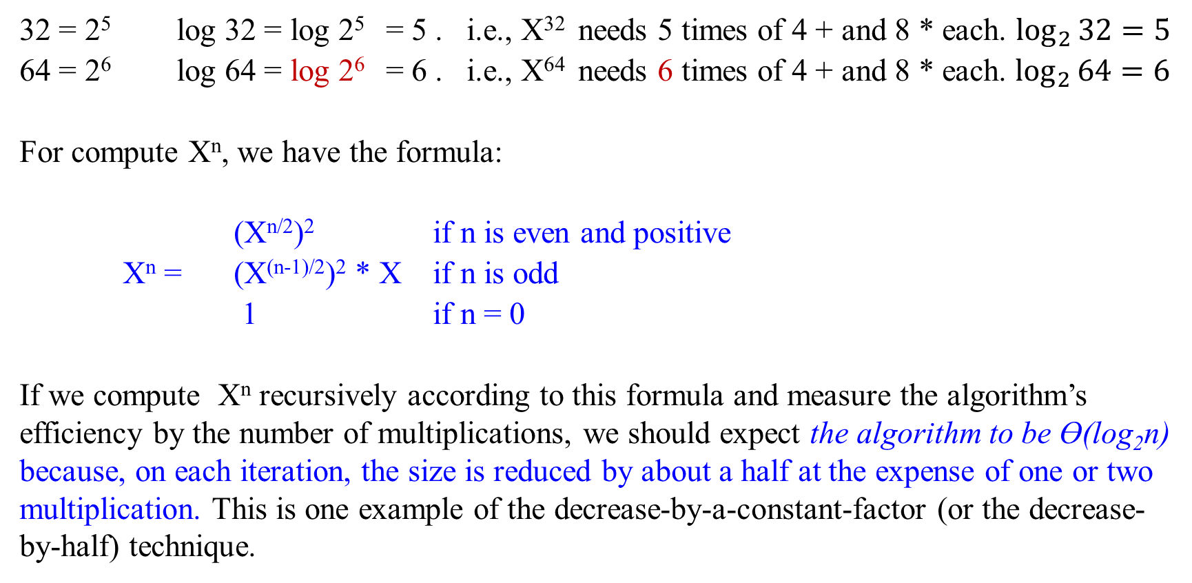
32 = 2⁵ log 32 = log 2⁵ = 5 . i.e., X³² needs 5 times of 4 + and 8 * each. $\log_{2}{32=5}$
64 = 2⁶ log 64 = log 2⁶ = 6 . i.e., X⁶⁴ needs 6 times of 4 + and 8 * each. $\log_{2}{64=6}$
For compute X^{n}, we have the formula:
(X^{n/2})² if n is even and positive
X^{n} = (X^{(n-1)/2})² * X if n is odd
1 if n = 0
If we compute X^{n} recursively according to this formula and measure the algorithm’s efficiency by the number of multiplications, we should expect the algorithm to be Ɵ(log₂n) because, on each iteration, the size is reduced by about a half at the expense of one or two multiplication. This is one example of the decrease-by-a-constant-factor (or the decrease-by-half) technique.

Slide 68
Thus, the number of arithmetic operations needed by our matrix-based algorithm Fib3 is just O(log₂n), as compared to O(n) for Fib2. Have we broken another exponential barrier?
The catch is that our new algorithm Fib3 involves
multiplication, not just addition; and
multiplications of large numbers are slower than additions.
When the complexity of arithmetic operations is taken into account, the running time of Fib3 becomes O(n²).

Slide 69

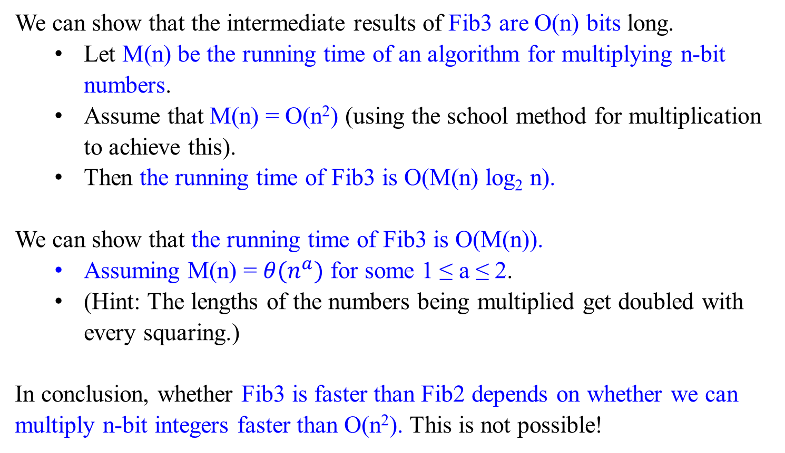
We can show that the intermediate results of Fib3 are O(n) bits long.
Let M(n) be the running time of an algorithm for multiplying n-bit numbers.
Assume that M(n) = O(n²) (using the school method for multiplication to achieve this).
Then the running time of Fib3 is O(M(n) log₂ n).
We can show that the running time of Fib3 is O(M(n)).
Assuming M(n) = $θ(n^{a})$ for some 1 ≤ a ≤ 2.
(Hint: The lengths of the numbers being multiplied get doubled with every squaring.)
In conclusion, whether Fib3 is faster than Fib2 depends on whether we can multiply n-bit integers faster than O(n²). This is not possible!

Slide 70

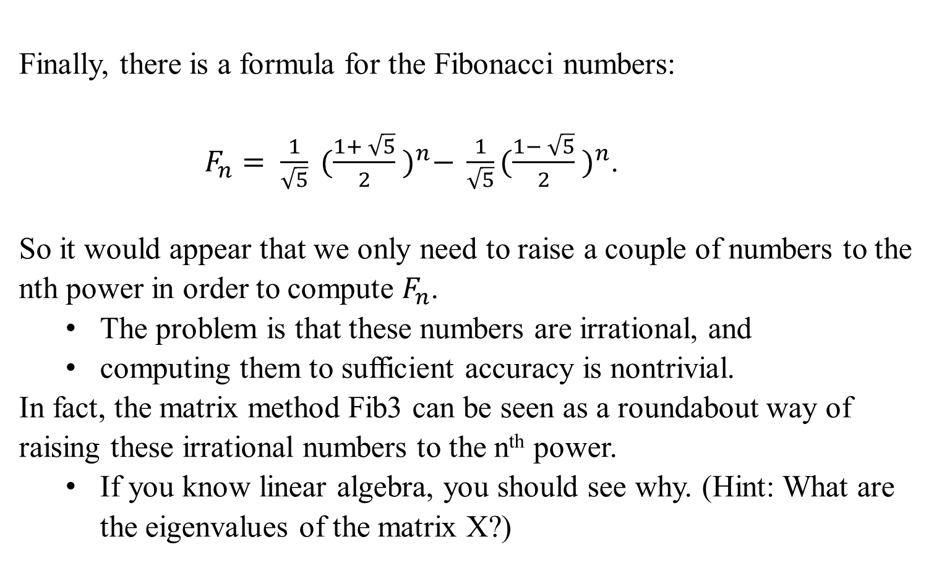
Finally, there is a formula for the Fibonacci numbers:
$F_{n}= \frac{1}{\sqrt{5}} {(\frac{1+ \sqrt{5}}{2} )}^{n}− \frac{1}{\sqrt{5}}{(\frac{1− \sqrt{5}}{2} )}^{n}$.
So it would appear that we only need to raise a couple of numbers to the nth power in order to compute $F_{n}$.
The problem is that these numbers are irrational, and
computing them to sufficient accuracy is nontrivial.
In fact, the matrix method Fib3 can be seen as a roundabout way of raising these irrational numbers to the n^{th} power.
If you know linear algebra, you should see why. (Hint: What are the eigenvalues of the matrix X?)

Slide 71
Remark:
The Fibonacci numbers were introduced by Leonardo Fibonacci in 1202 as a solution to a problem about the size of a rabbit population.
Many more examples of Fibonacci-like numbers have since been discovered in the natural world, and they have even been used in predicting the prices of stocks and commodities.
The worst-case inputs for Euclid’s algorithm happen to be consecutive elements of the Fibonacci sequence.
Euclid’s Algorithm is based on applying repeated the equality
gcd(m, n) = gcd(n, m mod n).
This is a typical example of the variable-size-decrease of decrease-and-conquer.

